Slide 1


The mistakes I made while studying
So you don’t have to make them too

Slide 2

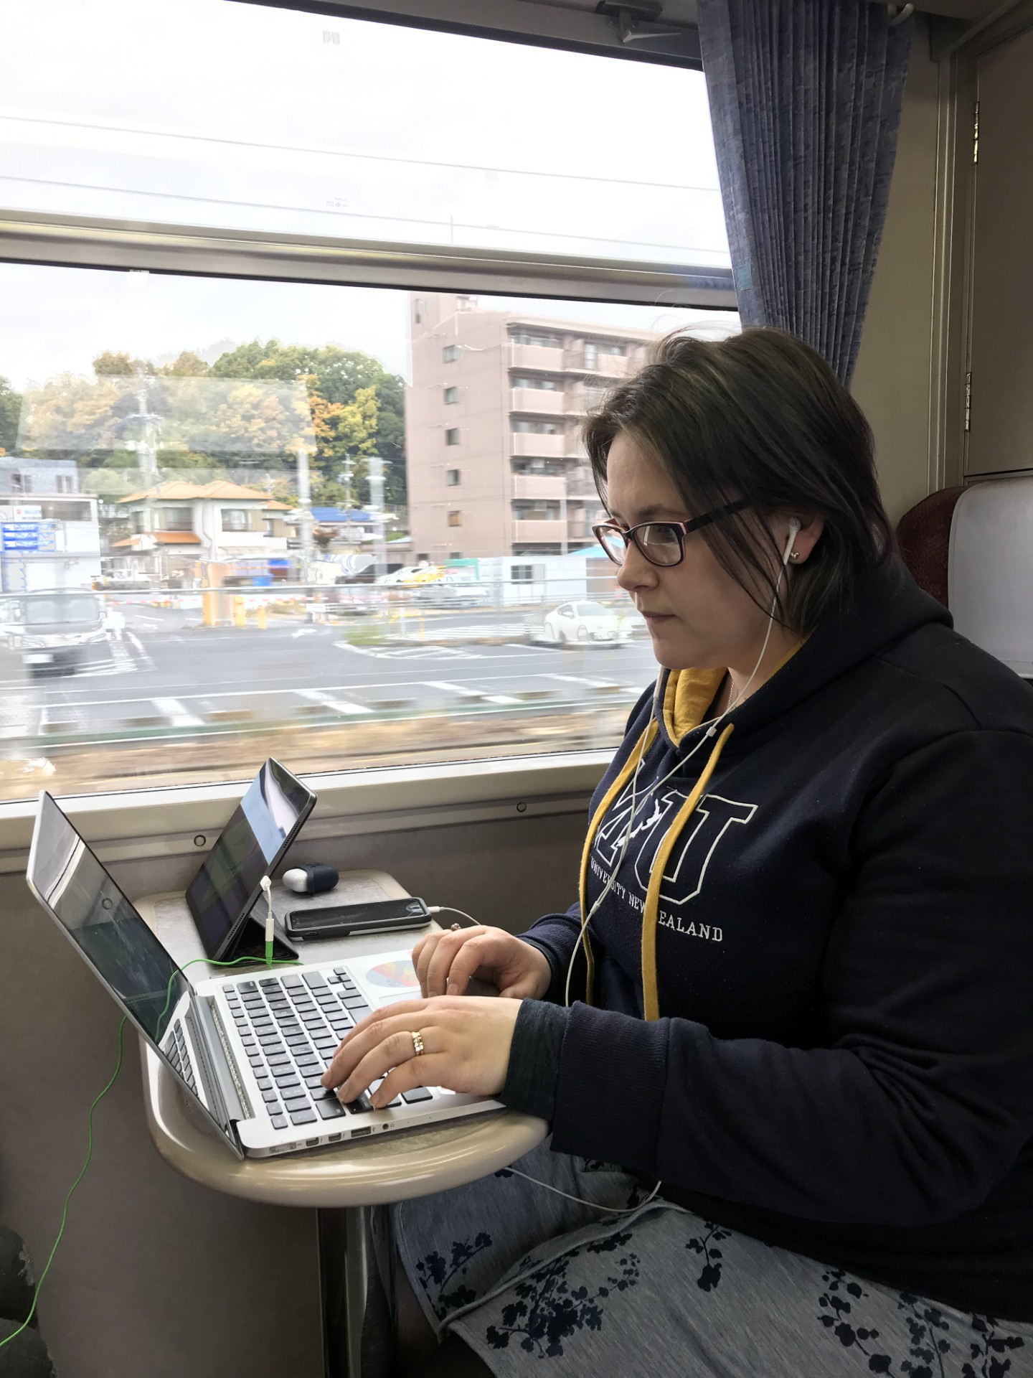
About me
Been in formal education for 22 years
Lecturer at Lincoln University (previously at Massey University and Victoria University of Wellington)
This is me editing my PhD on a train in Japan→
Here are some tips to avoid this

Slide 3
Set yourself up for success
Attend/watch all lectures and tutorials (even if they aren’t mandatory), often lecturers will give tips and tricks for the assignment in class
Read the course outline and make sure you have everything you need to fulfil the requirements, and if you are worried touch base with the lecturer as soon as possible
Take the time to understand the course materials, even if you aren’t being tested on them directly, papers are designed with the assumption you have done this work

Slide 4
Set up good working habits
University study should feel like a job, but it can’t become your whole life
Set study hours for yourself and commit to them regularly, your course outline will give you a guide of how many hours you need to devote to each paper in a semester
Have a Work-Life balance, if your study hours are Monday to Friday 9am to 4 pm then you should be doing anything else except studying on the weekends

Slide 5
Sometimes, clichés are true for a reason
Lecturers and tutors really can tell if you leave an assignment till the night before
Writing is a thinking process, ideally after writing your first draft you will give yourself a break before coming back to edit
Spell checking and reading your work out loud to yourself will help you catch many errors that distract your markers from your main points

Slide 6
You don’t have to do it all on your own
Asking questions in lectures is a great way to clarify your understanding, and there is always someone else who was wondering the same thing
Assignment deadlines are important, but sometimes we all need an extension, if you need more help reach out as soon as possible
The learning support team at the university are here for everyone, no matter what grade levels they are achieving, and everyone benefits from support

Slide 7
We all fall, how you pick yourself up again is what’s important
We are all here, at University, to learn and part of learning is making mistakes
We usually only hear about people’s successes, but our failures don’t need to define us
The times I have struggled the most in my academic journey are when I’ve felt like I am the only one that has ever had a hard time learning something new

